Slide 1
Team Auto Laser
By James Garrett & Ian Schuster

Slide 2
Team Auto Laser
Purpose Create a controllable laser pointer whose movement is coordinated based on a trained A.I. which detects and tracks objects such as balloons.
Goal Have the A.I. direct the laser pointer to point toward balloons with specific shapes drawn on them. Then wait for that balloon to be popped before moving to the next target.

Slide 3
Members and Advisor
Members | Contact Info
James Garrett | garretjb@mail.uc.edu
Ian Schuster | schustic@mail.uc.edu
Advisor
Professor Fred Annexstein | fred.annexstein@uc.edu

Slide 4
Project Abstract
The project consists of a camera, an arduino and motor, a laser pointer powerful enough to pop balloons, and an Artificial Intelligence that we must train to detect specific objects and shapes within its environment. The environment is defined as the vector space which is observed by the camera at the time of operation. The A.I. must be able to process the camera data to identify the position of the targets within the environment. Then, the A.I. will send this positional data to the Arduino. The Arduino and motor must be calibrated to operate strictly within the bounds of the environment defined by the camera data. Once this is calibrated, the Arduino will send the appropriate commands to the motor which will point the laser at the coordinates where the target is located.

Slide 5
User Stories
As an end user, I want to be able to have the system pop visible balloons with a laser.
As an end user, I want to be able to select a symbol from a list of symbols so that the artificial intelligence may target the symbol with the laser.
As an end user, I want the artificial intelligence to detect only balloons that have symbols on them so that random objects do not get burnt.
As an end user, I want to be able to stop the laser at any point (like a kill switch) in the event of an emergency.

Slide 6
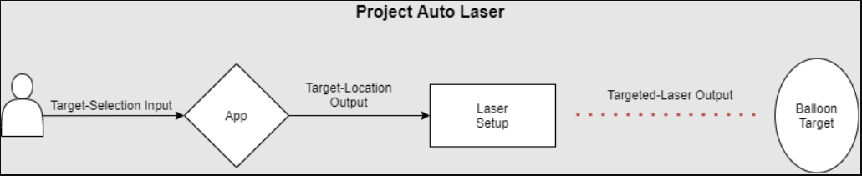
Design Diagrams: D0

Slide 7
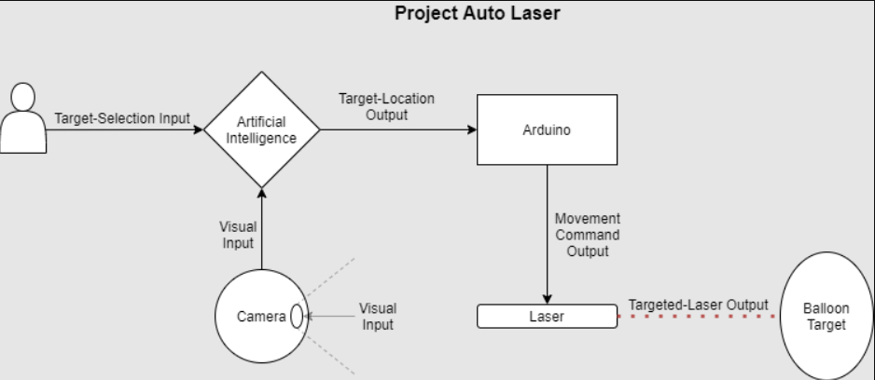
Design Diagrams: D1

Slide 8
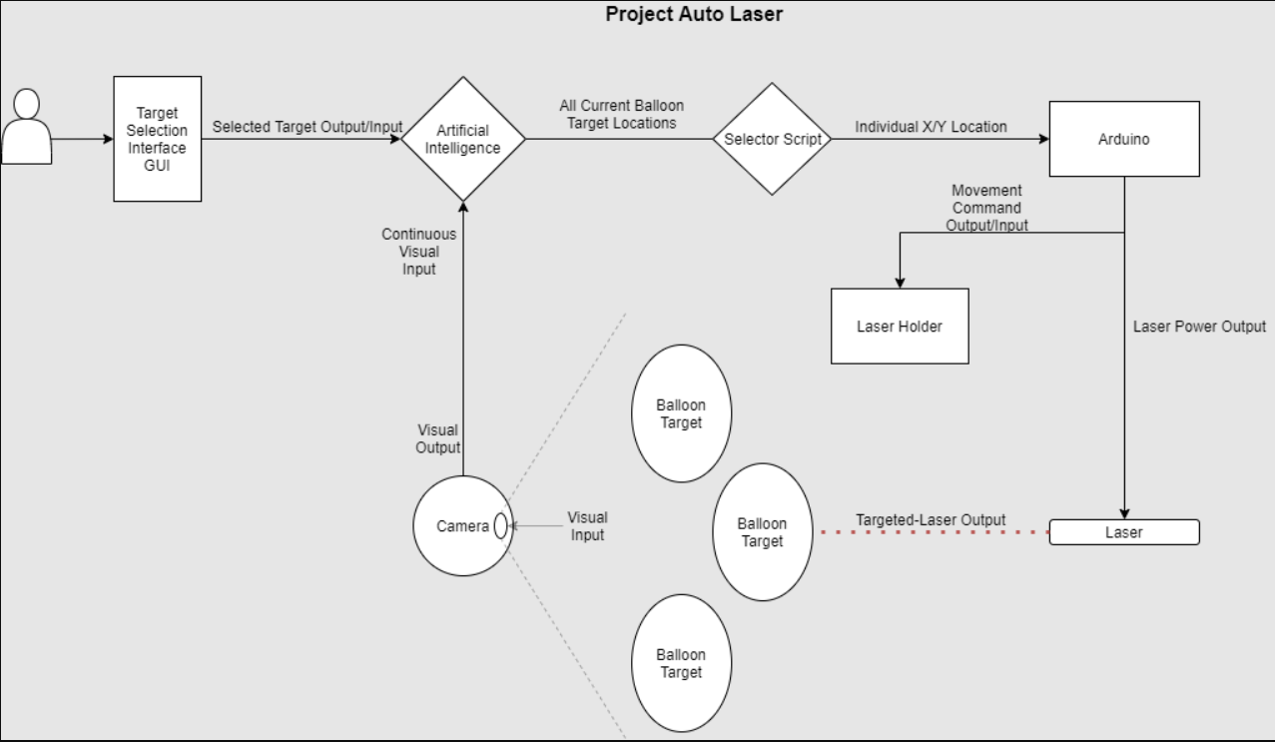
Design Diagrams: D2

Slide 9
Major Project Constraints
Economic Constraint This project requires a powerful enough laser to pop balloons. These types of lasers tend to be more expensive than typical keychain lasers and will likely be about half of our budget ($100-$250). Other costs include 3D printing materials, a motor and arduino, and lots of balloons.
Safety Constraint Since this project includes the usage of a powerful laser, a malfunction in the software could be harmful to anything within the vicinity of the laser. Therefore, proper safety precautions will have to be taken during project development. The system will need (at minimum) an emergency shut-off which will immediately disable the laser.
Scope Constraint The training of the A.I. requires decently powerful hardware. Therefore, it can not be determined yet if the system will be able to handle continuous video feedback. The precision of the system will also determine how specific the targeting can get in terms of recognizing color or symbols on the balloons.

Slide 10
Review of Project Progress
The 3D printing files for the arduino/motor/laser housing are created
Printing of these begins on October 31st.
Requirements are well established
Timeline is established and we are ahead of schedule
Responsibility per group member is well established
We have effectively defined the general scope and have identified the specifics of the camera system and arduino/motor/laser system.
We have agreed upon the “wants” and “needs” of the project (Examples below)
Want
It would be nice to be able to have the system track a moving balloon in real time.
Need
The system needs to be able to identify a balloon from an image and move the laser to point at the coordinates of that balloon.

Slide 11
Expected Accomplishments
Having trained an AI that can identify balloons via camera input and potentially differentiate based on color and/or symbols on said balloons.
Building a physical laser pointer system which can take in x/y coordinates and on/off commands for controlling a laser. Having a fully functioning system that can find and pop balloons in a room automatically at the push of a button.

Slide 12
Division of Work
James:
3D printing and assembling the physical laser pointer system
Linking arduino up with the motor and the laser pointer in the system
Ian:
Mapping x/y coordinates from the AI to commands for the laser pointer system.
Script which cycles through which balloon is currently being targeted, whether it has popped yet, and next target.
Shared:
High level design of project
Investigation of different AI libraries and frameworks
Training of AI
Obtaining required materials
Demoing final product

Slide 13
Expected Demo at Expo
Our expected demo will have us bringing in several balloons and our laser pointer system and demoing the system finding and popping the balloons. Depending on how precise our AI targeting system is we may also take in viewer input on which balloons should be popped based upon color and or symbols on the balloons.

